Slide 1
Comparison of RIM, N2, AIB Behavior in off food situation
-Cathy
2017/08/17

Slide 2
Behavior Comparison of AIB_nf, RIM_nf, N2_nf
✥ Direction 1: compare each type by a generalized summary, based on 9 videos randomly chosen, 3 for each type.
AIB_nf: AIB_nf3, AIB_nf7, AIB_nf9
RIM_nf: RIM_nf3, RIM_nf5, RIM_nf7
N2_nf: N2_nf1, N2_nf3, N2_nf5
✥ Direction 2: compare each type by single worms, 1 video from each type. The videos are AIB_nf3, RIM_nf7, N2_nf1
✥ Direction 3: compare by aggregating each type by all available HR videos
AIB_nf: 23 videos
RIM_nf: 7 videos
N2_nf: 5 videos

Slide 3
✥ Direction 1 Observations:
1. N2_nf have higher speed on average (high Mean Speed) and speed up more frequently than AIB_nf and RIM_nf (High Positive Mean of Acceleration).
2. RIM_nf shows higher variance in Acceleration than the other two types, which means the speed of RIM change swiftly.
Type | Summary | Speed | Acceleration | Angle | Angular_Velocity
AIB_nf | Mean | 104.32 | -5.53 | -0.53 | 1.37
 | Stdev | 75.11 | 112.69 | 91.15 | 0.64
 | Median | 109.11 | 0 | 0 | 1.45
 | Minimum | 0 | -3360.5 | -178.93 | 0
 | Maximum | 426.11 | 1742.89 | 179.2 | 3.06
RIM_nf | Mean | 162.57 | 3.79 | -12.08 | 1.52
 | Stdev | 65.03 | 158.17 | 100.8 | 0.7
 | Median | 166.34 | 4.19 | -18.42 | 1.52
 | Minimum | 0.01 | -3170.83 | -179.14 | 0
 | Maximum | 491.57 | 1674.88 | 179.2 | 3.84
N2_nf | Mean | 181.27 | 7.43 | 0.77 | 1.49
 | Stdev | 76.96 | 137.24 | 101.92 | 0.74
 | Median | 194.26 | 2.42 | 0 | 1.5
 | Minimum | 0 | -3928.27 | -179.16 | 0
 | Maximum | 499.92 | 3007.68 | 179.2 | 3.08
3. AIB_nf shows negative Mean of Acceleration,
which means AIB_nf decrease speed more frequently.
4. RIM_nf shows negative Mean/Median value for Angle,
which means RIM_nf is showing more movement in
downward direction.

Slide 4
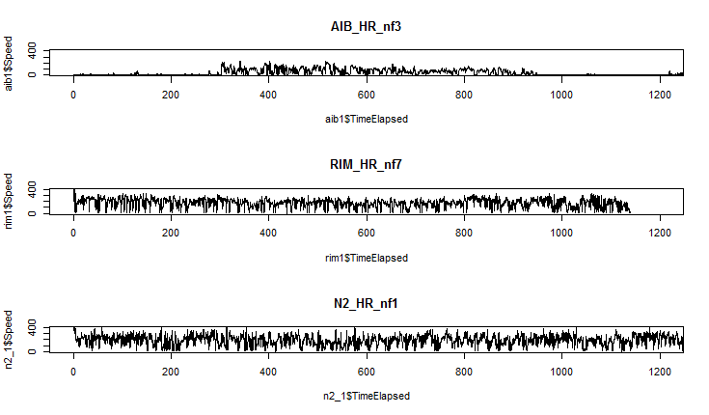
✥ Direction 2: compare 3 worms by –Speed over Time
Observation: AIB shows a lower variance in
speed, while N2 has the highest
speed variance.

Slide 5
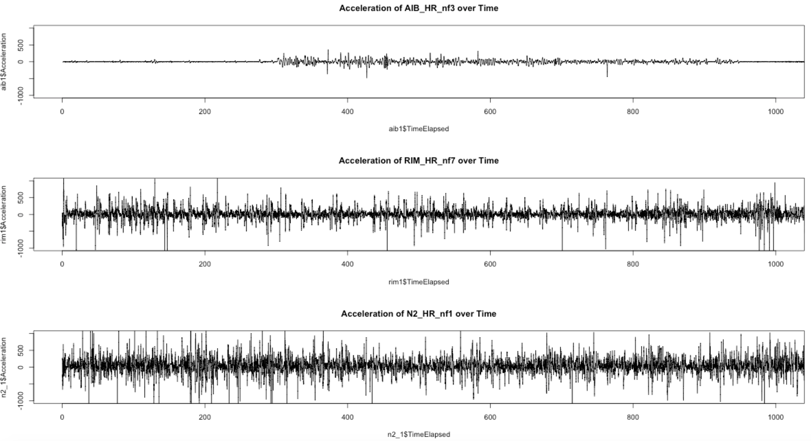
✥ Direction 2: compare 3 worms by –Acceleration over Time
Observation: RIM shows high variance in acceleration.

Slide 6
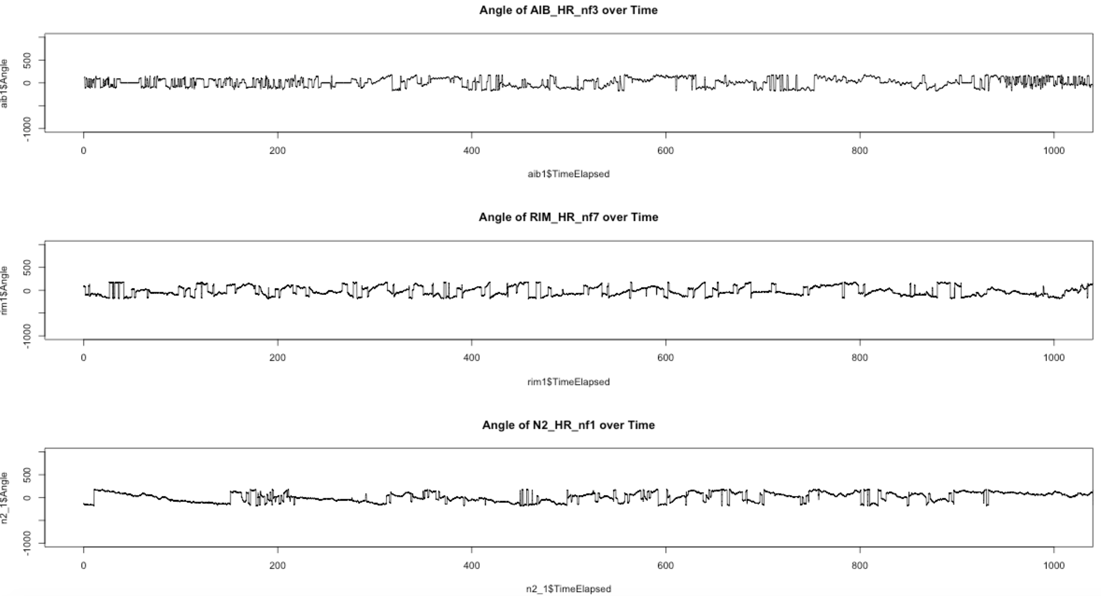
✥ Direction 2: compare 3 worms by –Angle over Time
Observation: AIB and RIM shows similar pattern of frequent angle change over time, which are different from N2. This means AIB_nf and RIM_nf change moving direction more frequently than N2.

Slide 7
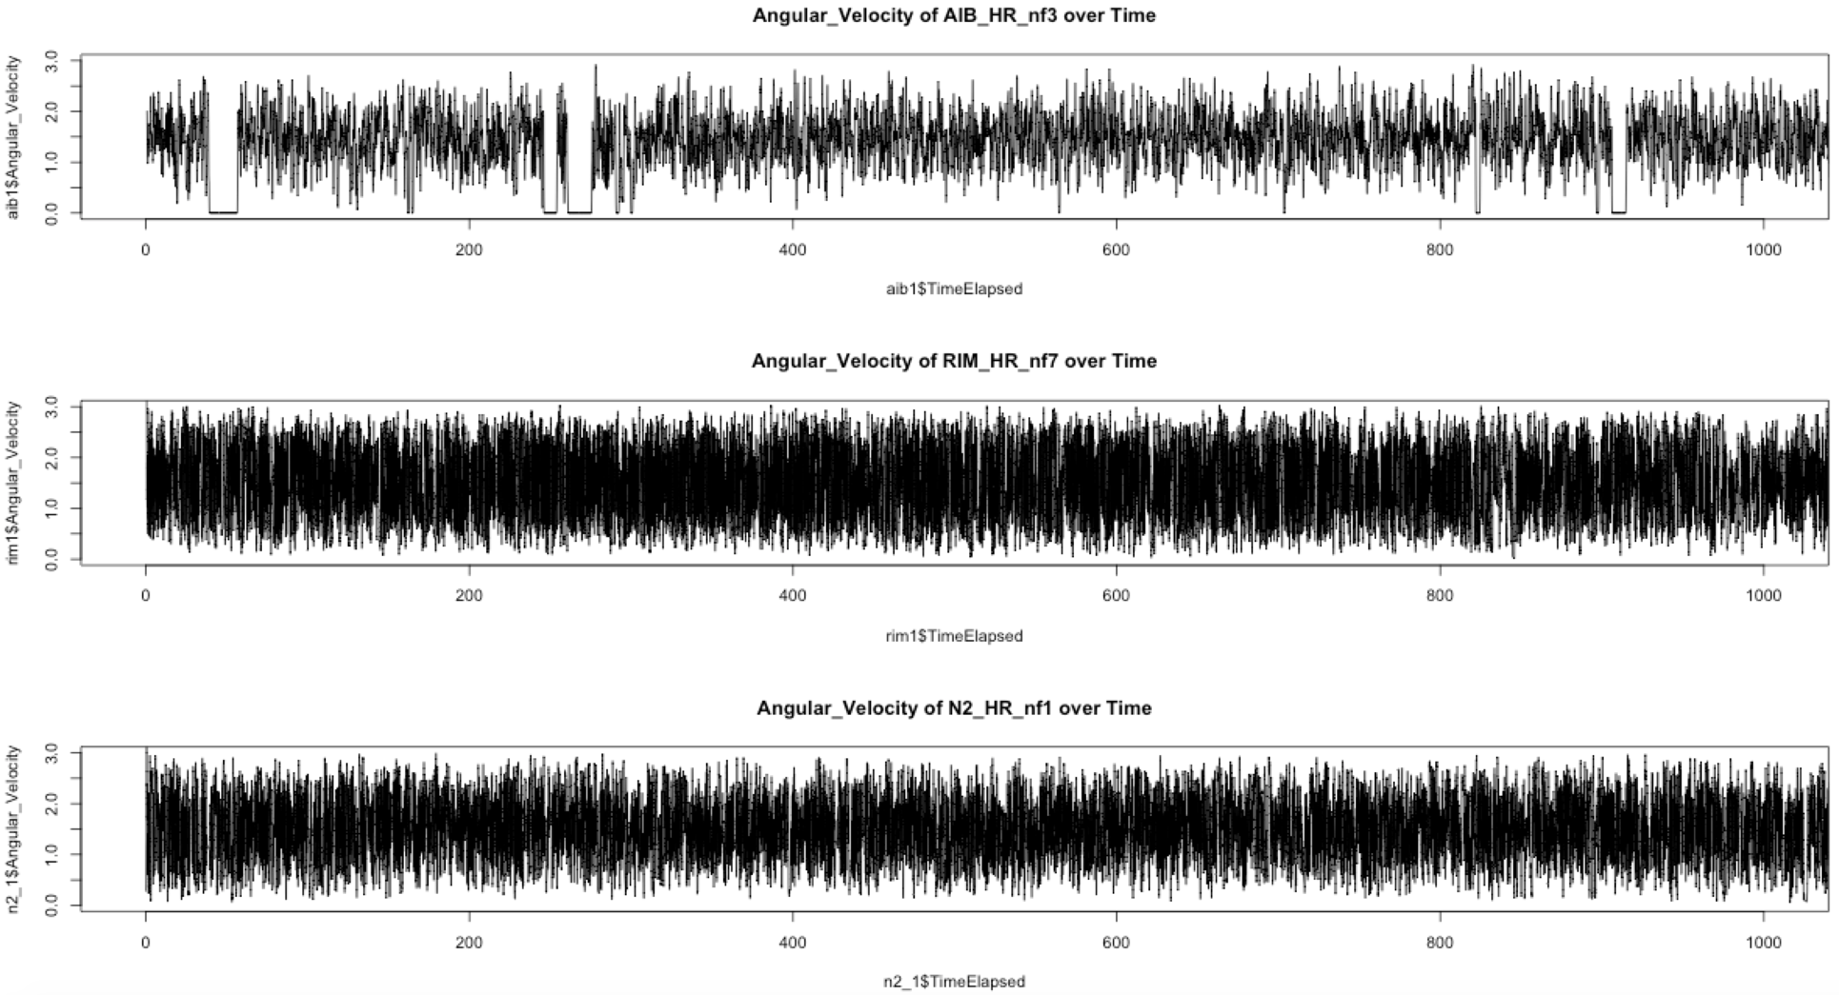
✥ Direction 2: compare 3 worms by –Velocity of Angle over Time
Observation: AIB shows
different pattern of velocity
of Angle, it displays periods of unchanged angle, which means more movement in one direction.

Slide 8
✥ Direction 3: Behavior comparison by aggregating each type
Observation 1: The Behavior of RIM is persistent through all videos with more downward movement ( Negative Mean of Angle) and changing moving direction frequently(high variance observed in Angle and high Mean of Angular_Velocity).
Observation 2: Behavior of AIB_nf is also persistent in
decreasing speed more frequently( negative Mean Acceleration).
Observation 3: AIB_nf is also changing speed frequently overall
more than the other type( high variance in Speed).
Observation 4: The speed of N2 is overall higher than the other two type( high Mean Speed).

